Slide 1
Introduction to binary classification

Slide 2
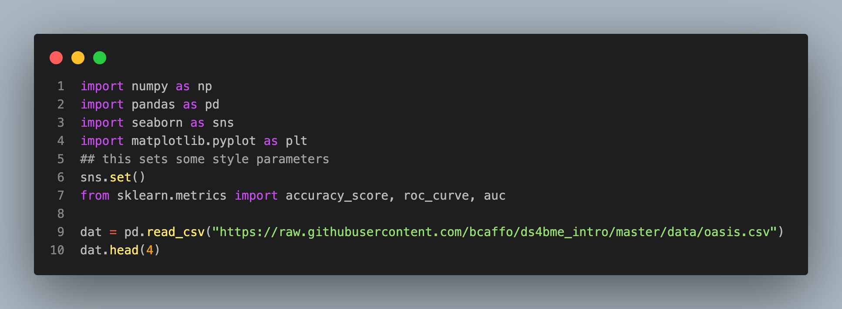
 | FLAIR | PD | T1 | T2 | FLAIR_10 | PD_10 | T1_10 | T2_10 | FLAIR_20 | PD_20 | T1_20 | T2_20 | GOLD_Lesions
0 | 1.143692 | 1.586219 | -0.799859 | 1.634467 | 0.437568 | 0.823800 | -0.002059 | 0.573663 | 0.279832 | 0.548341 | 0.219136 | 0.298662 | 0
1 | 1.652552 | 1.766672 | -1.250992 | 0.921230 | 0.663037 | 0.880250 | -0.422060 | 0.542597 | 0.422182 | 0.549711 | 0.061573 | 0.280972 | 0
2 | 1.036099 | 0.262042 | -0.858565 | -0.058211 | -0.044280 | -0.308569 | 0.014766 | -0.256075 | -0.136532 | -0.350905 | 0.020673 | -0.259914 | 0
3 | 1.037692 | 0.011104 | -1.228796 | -0.470222 | -0.013971 | -0.000498 | -0.395575 | -0.221900 | 0.000807 | -0.003085 | -0.193249 | -0.139284 | 0

Slide 3
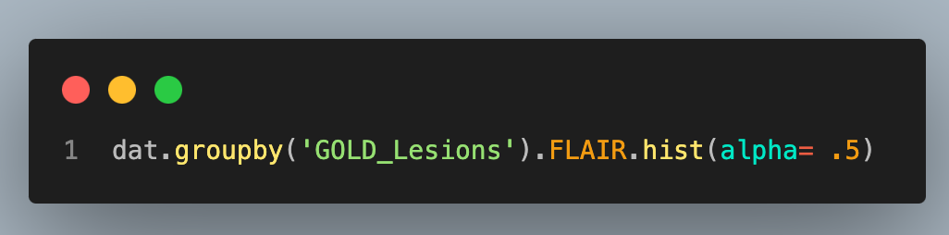
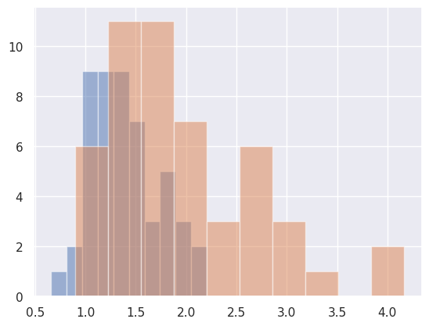

Slide 4
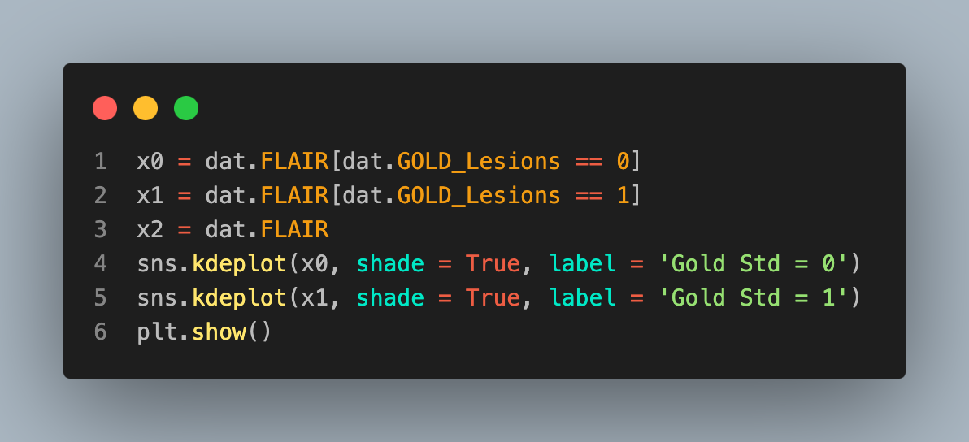
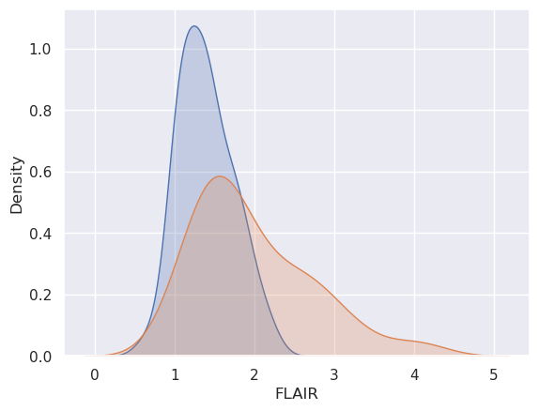

Slide 5
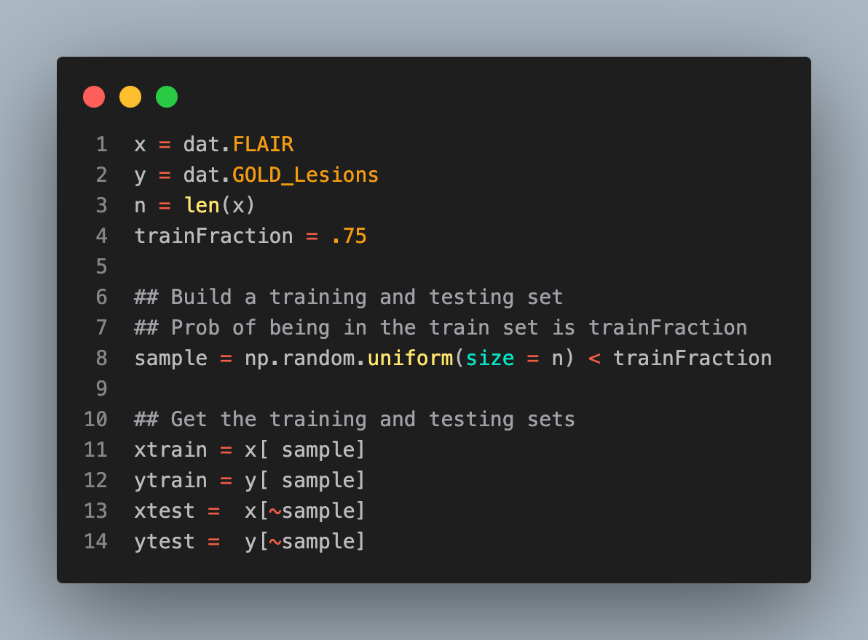
Classification

Slide 6
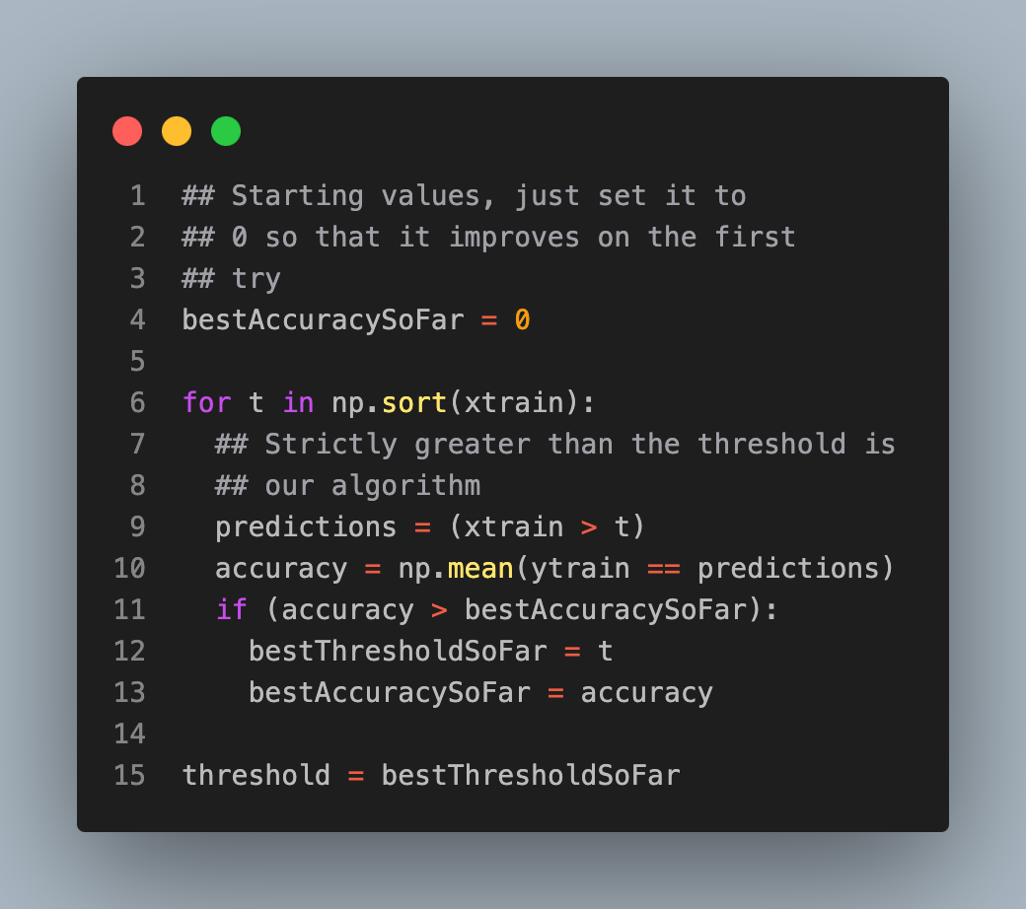

Slide 7
Definitions
test set accuracy = proportion of correct classifications on the test data
test set sensitivity = proportion declared diseased among those that are actually diseased. (In this case lesion = disease)
test set specificity = proportion declared not diseased among those that are actually not diseased.

Slide 8
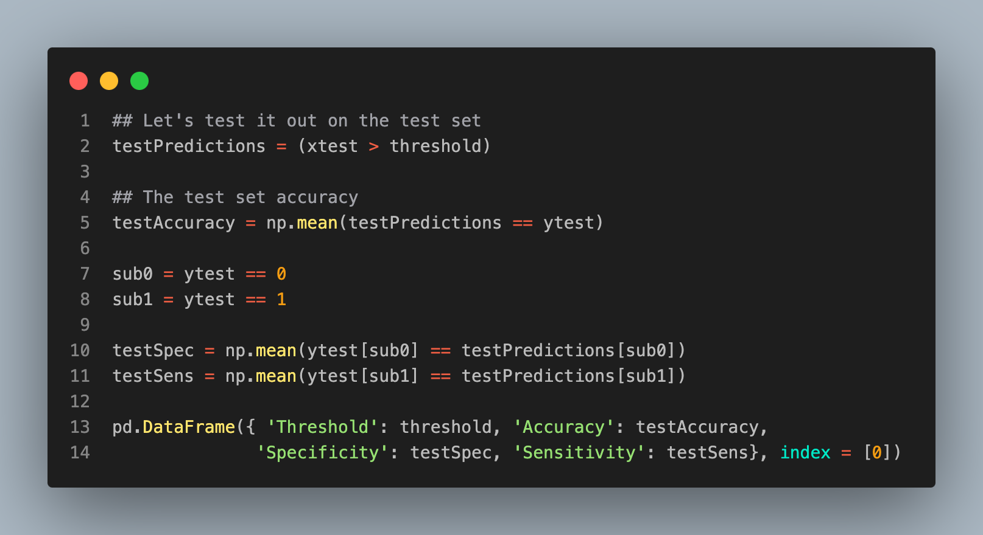
 | Threshold | Accuracy | Specificity | Sensitivity
0 | 1.580589 | 0.62963 | 0.7 | 0.588235

Slide 9
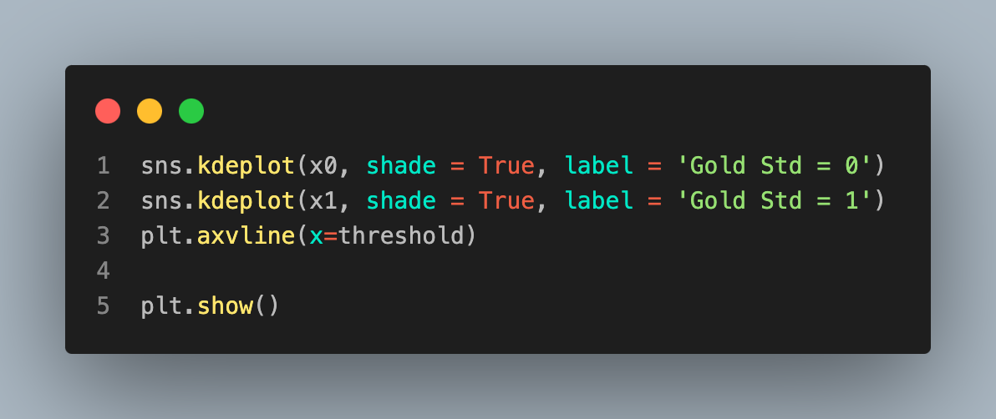
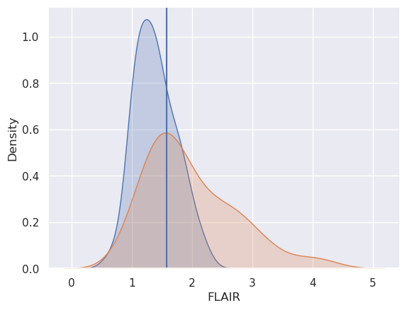

Slide 10
